Slide 1
Networking Basics

Slide 2
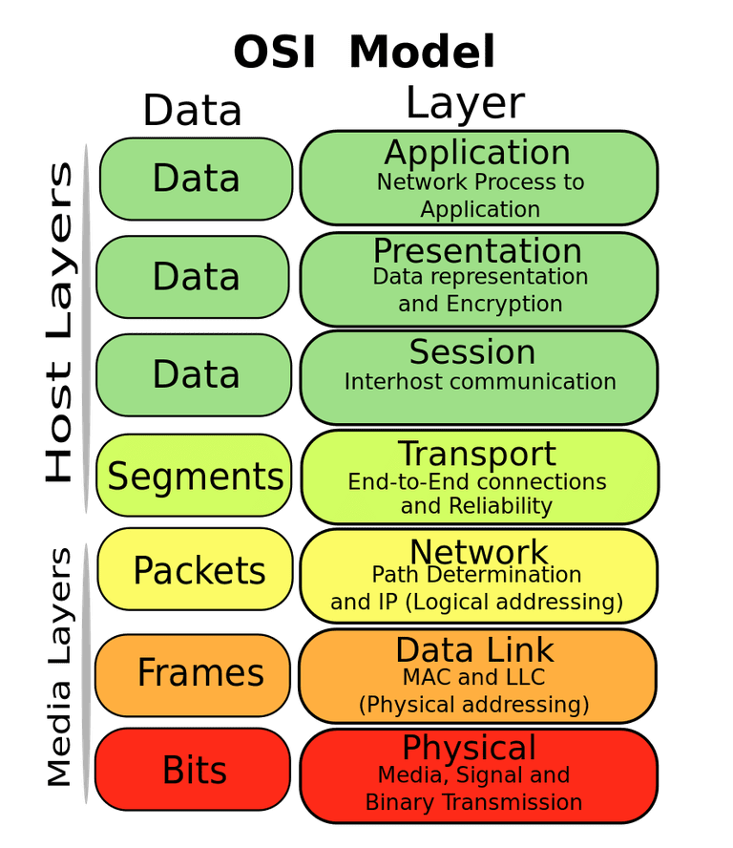
OSI Model (A.K.A. “seven-layer model”)
Each layer encodes or encapsulates data from the layer above
A given layer shouldn’t care about how the layer below encodes its data
E.g., the data link layer shouldn’t care if its data is encoded as electrical signals on copper wire or pulses of light in a fiber in the physical layer

Slide 3
Physical Layer

Slide 4
Physical Layer
The physical layer encodes bits of data into some phenomenon in the physical world
Examples:
Voltage pulses on copper wire
Laser pulses in an optical fiber
Phase modulation in a radio signal

Slide 5
“Ethernet”
Technically, Ethernet (IEEE 802.3) is a layer 2 (Data Link) standard
It’s possible to send Ethernet frames over optical fiber, for example
“Ethernet” is colloquially used to refer to:
10/100/10GBASE-T physical implementations
The 8P8C modular connector

Slide 6
10/100/1GBASE-T
Layer 1 (Physical) implementation of Ethernet over twisted-pair cable
10, 100, and 1G are used to refer to bitrates of 10 MBPS, 100 MBPS, and 1 GPBS, respectively
“Base” means baseband signaling (i.e., very narrow frequency range)
“T” stands for twisted pair cable
E.g., “100BASE-T” is a protocol that encodes Ethernet frames at 100 MBPS, using baseband signaling, on twisted-pair cable

Slide 7
Twisted Pair Cable
Differential signaling:
Uses wires in pairs, instead of n wires and a ground
Improves noise immunity
Allows isolation to prevent ground loops
Pairs of wires are twisted to reduce vulnerability to interference and crosstalk

Slide 8
Cat 5e
Most common “Ethernet” cables
Refers to “Category 5, enhanced”
Cat 3, cat 5, etc. are standards published by the Telecommunications Industry Association (TIA)
Consists of four pairs: orange/orange-white, green/green-white, blue/blue-white, and brown/brown-white

Slide 9
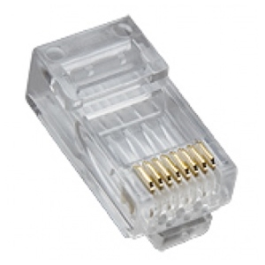
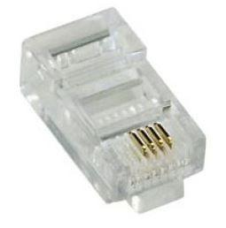
8P8C Connector
Often incorrectly referred to as “Ethernet” or “RJ45” connector
“8P” – 8 positions
“8C” – 8 contacts (i.e., all positions populated)
Compare 8P4C connector:

Slide 10
8P8C Connector
There are two ways to wire Cat 5e cable into 8P8C connectors; standards designated TIA/EIA-568A and TIA/EIA-568B
The -B standard is slightly better at reducing crosstalk, but the most important thing is that both ends of a cable are wired the same

Slide 11
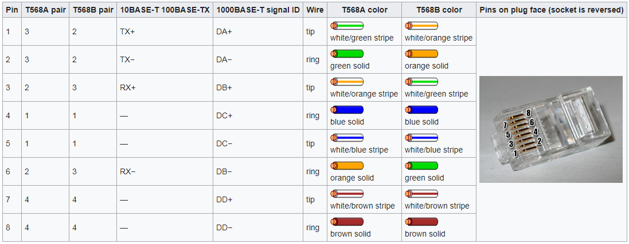
8P8C Connector
Note: 10 M and 100 M only use 2 of the 4 pairs, one in each direction. 1G uses all four pairs.

